Slide 1
Screening for gynecological cancer
Prepared by :
Khalid Aldossari
Fahad Alshehri
Ali Al-Mater
Supervised by : Dr. ELSHEIKH

Slide 2
Out lines :
WHO principles for screening tests .
HPV ( infection , prevention , vaccination )
Cervical precancerous lesions .
Cervical cancer screening ( cytology , colposcopy ,histopathology )
Management of Cervical precancerous lesions ( CIN)
Ovarian and endometrial cancer screening …. Evidence based results .

Slide 3
Out lines :
WHO principles for screening tests .
HPV ( infection , prevention , vaccination )
Cervical precancerous lesions .
Cervical cancer screening ( cytology , colposcopy ,histopathology )
Management of Cervical precancerous lesions ( CIN)
Ovarian and endometrial cancer screening …. Evidence based results .

Slide 4
Who principles for screening and early detection of a disease :
(1) The condition should be an important health problem.
(2) There should be an accepted treatment for patients with recognized disease.
(3) Facilities for diagnosis and treatment should be available.
(4) There should be a recognizable latent or early symptomatic stage.
(5) There should be a suitable test or examination.
(6) The test should be acceptable to the population.

Slide 5
Cont ..
(7) The natural history of the condition, including development from latent to declared disease, should be adequately understood.
(8) There should be an agreed policy on whom to treat as patients.
(9) The cost of case-finding (including diagnosis and treatment of patients diagnosed) should be economically balanced in relation to possible expenditure on medical care as a whole.
(10) Case-finding should be a continuing process and not a "once and for all" project .

Slide 6
The success of screening programs depends on a number of fundamental principles:
The target disease should be a common form of cancer, with high associated morbidity or mortality;
Effective treatment, capable of reducing morbidity and mortality, should be available;
Test procedures should be acceptable, safe, and relatively inexpensive.

Slide 7
Out lines :
Who principles for screening tests .
HPV ( infection , prevention , vaccination )
Cervical precancerous lesions .
Cervical cancer screening ( cytology , colposcopy ,histopathology )
Management of Cervical precancerous lesions ( CIN)
Ovarian and endometrial cancer screening …. Evidence based results .

Slide 8
Human Papillomavirus (HPV)
HPV is the most common sexually transmitted virus in the United States. about 75% of sexually active people will have genital HPV at some time in their lives.
There are more than 40 HPV types that can infect the genital areas of males and females. These HPV types can also infect the mouth and throat .

Slide 9
Signs and Symptoms
Most HPV cases are latent infections with no visible lesions and are only diagnosed by DNA hybridization testing performed in the evaluation of abnormal pap smear .
Sub clinical infections have lesions that are only visible during colposcopy .
Asymptomatic genital HPV infection is common and usually self-limited.
clinical infections are characterized by readily visible “ warty “ growths called condylomata acuminata on the vulva , vagina , cervix ,urethra , and perianal area .

Slide 10
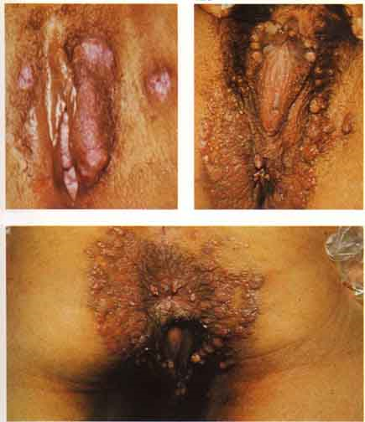
condylomata acuminata

Slide 11
Types of HPV :
Oncogenic, or high-risk HPV types (e.g., HPV types 16 and 18), are the cause of cervical cancers. These HPV types are also associated with other anogenital cancers in men and women, including penile, vulvar, vaginal, and anal cancer, as well a subset of oropharyngeal cancers .
Persistent oncogenic HPV infection is the strongest risk factor for development of precancers and cancers

Slide 12
Nononcogenic, or low-risk HPV types (e.g., HPV types 6 and 11), are the cause of genital warts and recurrent respiratory papillomatosis ( RRP )

Slide 13
Tests :
HPV tests are available for women aged >30 years undergoing cervical cancer screening. These tests should not be used for men, for women <20 years of age, or as a general test for STDs. These HPV tests detect viral nucleic acid (i.e., DNA or RNA) or protein.

Slide 14
Transmission
Transmission of HPV can occur even when there are no visible lesions :
1) Direct skin-to-skin contact
2) Sexual activity (Oral, Vaginal & Anal sex)
Regular condom use may provide some degree of protection .
During pregnancy , condylomata may increase in number and size , but transmission from mother to infant is rare .

Slide 15
Diagnosis Of HPV
Abnormal Pap smear
HPV DNA Lab test
Clinical diagnosis of genital warts
Examine infected tissue under a microscope

Slide 16
Prevention
Two HPV vaccines are
a bivalent vaccine (Cervarix) containing HPV types 16 and 18 and a quadrivalent vaccine (Gardasil) vaccine containing HPV types 6, 11, 16, and 18.
Both vaccines offer protection against the HPV types that cause 70% of cervical cancers (i.e., types 16 and 18), and the quadrivalent HPV vaccine also protects against the types that cause 90% of genital warts (i.e., types 6 and 11)

Slide 17
Either vaccine can be administered to girls aged 11–12 years and can be administered to those as young as 9 years of age girls .
women ages 13–26 years who have not started or completed the vaccine series also should receive the vaccine.
The quadrivalent (Gardasil) HPV vaccine can also be used in males aged 9–26 years to prevent genital warts .

Slide 18
Both HPV vaccines are administered as a 3-dose series of IM injections over a 6-month period …( at time 0 ,2 , and 6 months )
For full benefit ,should be administered before onset of sexual activity( i.e. before exposure to virus )
Not designed to treat active infections .
Conception should be avoided until 30 days after last dose of vaccination .
Contraindicated for pregnant women .

Slide 19
Women who have received HPV vaccine should continue routine cervical cancer screening because 30% of cervical cancers are caused by HPV types other than 16 or 18 .

Slide 20
Treatment ;
The reasons for treating genital warts are to relieve symptoms ( pain and bleeding ) and to ameliorate psychological and cosmetic concerns of the pt.
Provider-applied topical therapies include :
Podophyllin resin 10% to 25% in tincture of benzooin
Trichloroacetic acid (TCA) or bichloroacetic acid (BCA) 80% to 90%

Slide 21
Patient applied topical therapies :
1) Podofilox 0.5% solution or gel .
2) Imiquimod 5% cream (acts as an immune response modifier)
Surgical therapies include :
Cryotherapy .
Surgical excision .
Electorocautery .
Laser vaporization .
Intra lesional interferon .
Notice : Podophyllin , Podofilox, and imiquimod should not be used during pregnancy .

Slide 22
Out lines :
Who principles for screening tests .
HPV ( infection , prevention , vaccination )
Cevical precancerous lesions .
Cervical cancer screening ( cytology , colposcopy ,histopathology )
Management of Cervical precancerous lesions ( CIN)
Ovarian and endometrial cancer screening …. Evidence based results .

Slide 23
overview
Anatomy:
Endocervix : opening of the cervix into uterine cavity. It is lined with columnar epithelium.
Ectocervix: the portion of the cervix that extends into vagina. It is lined with stratified squamous epithelium.

Slide 24
The junction between endocervix (columnar epithelium) and ectocervix (squamous epithelium) is known as “Squamo-Columnar Junction”. The position of SCJ varies throughout the female reproductive life.

Slide 25
estrogen levels (e.g. puberty, pregnancy)
Moves SCJ towards external os
Exposing Columnar epithelium to the vaginal acid environment
Convert to squamous epithelium

Slide 26
Transformation Zone:
The area of metaplastic squamous epithelium located between the original SCJ and the new SCJ.
NOTICE : In about 4 % of normal female infants and about 30% of those exposed to diethylstilbestrol in utero , the columnar epithelium extends onto the vaginal fornices .

Slide 29
presentation
Asymptomatic.

Slide 30
Malignancy potential
Progress to be malignant in 8-10 years.
Most lesions will spontaneously regress, others remain static, with only a minority progress to cancer.
HPV 16, 18, 31, 33 and 35 are the most common HPV types associated With premalignant and cancerous lesions of the cervix.

Slide 31
Risk Factors
1- HPV infection:
high risk: types 16, 18
(99% of cervical cancers contain one of them)
low risk: types 6, 11.
2- Immunosuppression (HIV infection).
3- STI: trichomonas, HSV.
4-early age of sexual intercourse.
5- multiple sexual partners.
6- smoking.
7- low socioeconomic status.

Slide 32
Benign cervical leesions
i . Nabothian cyst / inclusion cyst
- no treatment is required
ii. Endocervical polyps
- treatment is polypectomy
( office procedure )

Slide 33
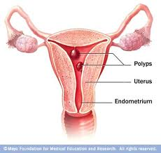
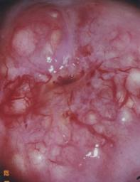
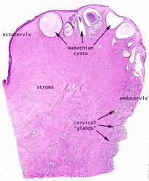
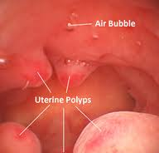

Slide 34
Cervical intraepithelial neoplasia
CIN represents a spectrum of disease ranging from CIN I ( mild dysplasia ) to CIN III ( severe dysplasia and carcinoma in situ ) .
At least 35% of patients with CIN III develop invasive cancer within 10 years , whereas lower grades of CIN often spontaneously regress.

Slide 35
With CIN , there is abnormal epithelial proliferation above the basement membrane .
Involvement of the inner 1/3 of the epithelium represents CIN 1
Involvement of the inner ½ to 2/3 represents CIN II .
Full thickness involvement represents CIN III
with intact basement membrane . (carcinoma in situ)
The disease is asymptomatic .

Slide 36
Normal

Slide 39
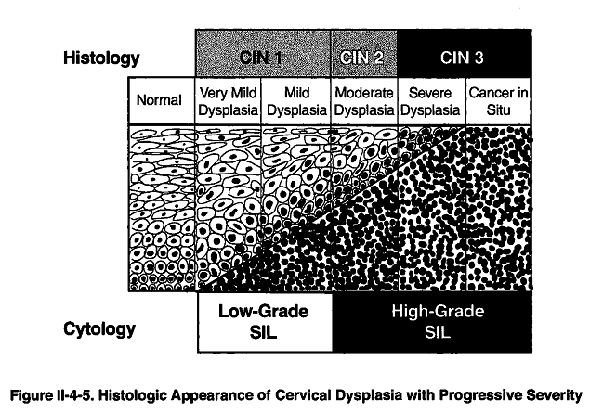

Slide 40
Out lines :
Who principles for screening tests .
HPV ( infection , prevention , vaccination )
Cervical precancerous lesions .
Cervical cancer screening ( cytology , colposcopy ,histopathology )
Management of Cervical precancerous lesions ( CIN)
Ovarian and endometrial cancer screening …. Evidence based results .

Slide 41
Cervical cancer screening
The aim of modern screening programmes is mainly the detection of the non-invasive precursor of the disease, cervical intra-epithelial neoplasia (CIN) in the asymptomatic population in order to reduce mortality and morbidity.

Slide 42
Screening of asymptomatic women
The American College of Obstetricians and Gynecologists has recommended that all women undergo an annual physical examination , including a Pap smear , within 3 years of sexual intercourse , or by age 21 years .
Annual screening should occur until age 30 years .

Slide 43
Cervical screening guidelines (Pap test)
Endocervical and exocervical cell sampling , TZ sampling .
False positives 5-10%
False negatives 10-40% (higher for glandular lesions and for invasive cancers ) …
- (so, Pap smear identify the patient who has pre-cancerous lesions and not the one who has invasive cancer. )
Identifies SCC , less reliable for adenocarcinoma .
All women – stat screening at age 21 or 3 years after onset of vaginal intercourse .
woman > 30 years – if 3 consecutive normal paps, can get screened every 2-3 years.

Slide 44
When to discontinue?
1- Women older than 70 years, if 3 consecutive normal paps, and NO abnormal paps in the last 10 years, can discontinue screening.
2- After total hysterectomy, if performed for a benign disease.
( subtotal >>> continue screening according to guidelines )

Slide 45
Exceptions to guidelines :
Immunocompromised (transplant, steroids )
DES exposure
HIV and high risk
Unscreened patients .
NOTICE : (Pap smear is not diagnostic ,
for Dx. Tissue biopsy is mandatory).

Slide 46
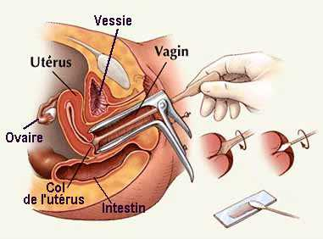

Slide 47
Classification of an abnormal Papanicolaou smear :
Bethesda classification :
For reporting cervical and vaginal cytology .
Epithelial cell abnormalities :
( sequamos and glandular cells )
Squamous cell :
1- Normal:
negative for intra-epithelial lesion or malignancy.

Slide 48
2- Atypical squamous cells (ASC):
Can be either:
a) ASC-US = Undetermined significance.
b) ASC-H = Can not exclude HSIL.

Slide 49
ASC-US “borderline”

Slide 50
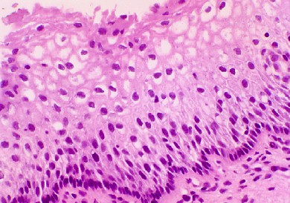
3- Low-grade squamous epithelial lesion (LSIL):
biopsy will demonstrate histologic findings of HPV, mild dysplasia, or CIN I.

Slide 51
4- High-grade Squamous Intra-epithelial Lesion (HSIL):
Biopsy will demonstrate histologic findings of moderate dysplasia, severe dysplasia, CIS, CIN II, or CIN III.

Slide 52
5- sequamous cell carcinoma :
Biopsy will demonstrate histologic findings of invasive cancer.

Slide 53
If negative for intra epithelial lesions or malignancy :
Organisms ( e.g. Trichomonas Vaginitis )
Reactive cellular changes associated with inflammation ( includes typical repair ) , radiation , intrauterine contraceptive device .
Atrophy .

Slide 54
Bethesda System | HPV Type | Morphology | CIN | Dysplasia
Low-grad SIL ( L-SIL ) | 6 ,11 | Koilocytic atypia , Flat condyloma | CIN 1 | Mild
High-grade SIL (H-SIL) | 16 , 18 | Progressive cellular atypia , loss of maturation | CIN II & CIN III | Moderate , Severe , Carcinoma in Situ .

Slide 55
Glandular cell :
Atypical glandular cells (AGC) ( specify endocervical , endometrial ,or not otherwise specified )
Atypical glandular cells , favor neoplastic
( specify endocervical or not otherwise specified ) .
Endocervical adenocarcioma in situ ( AIS ) .
Adenocarcinoma .

Slide 56
Colposcopy
Is inspection of the cervix using a binocular microscope with a light source.
Indication:
Presence of dysplastic cells or malignant cells on cytology.
An outpatient procedure
An appropriate sized speculum is inserted to expose the cervix , which is cleaned with a cotton soaked in 3 % acetic acid to remove adherent mucus and cellular debris .
The original sequamous epithelium appears gray and homogenous . The columnar epithelium appears red and grape-like .

Slide 57
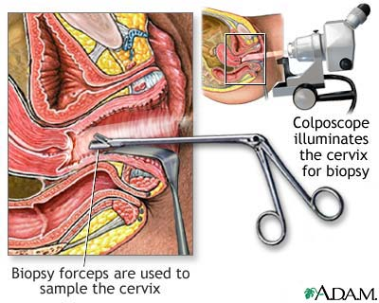
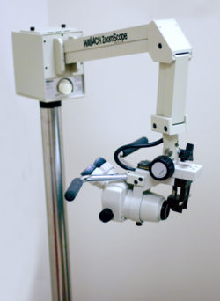

Slide 58
The transformation zone can be identified by the presence of gland openings that are not covered by the sq. metaplasia and by the paler color of the metaplastic epithelium compared with the original seq.epith .
Nabothian follicles may also be seen in the transformation zone .

Slide 59
Neoplastic cells appear as a white area with a well-defined edge following application of 5% acetic acid solution.
Diagnosis is confirmed by taking a biopsy from the most abnormal-looking areas.

Slide 60
Colposcopy
Colposcopy of the cervix (centre) with CIN 1dysplasia
Figure 12.2 Hlis figure shows
Acetowhite epithelium.

Slide 61
Biopsy and endocervical curettage :
If the colposcopic examination is satisfactory ,
A punch biopsy is taken from the worst area or areas together with endocervical curettage .
The endocervical curettage is not performed in patients who are pregnant .
A diagnostic cone biopsy of cervix is indicated in the following circumstances :
1- Pap smear shows a high grade lesions , and a colposcopic examination is unsatisfactory .
2- endocervical curettage shows a high-grade lesion.
3- Pap smear shows adenocarcinoma in situ .
4-Microinvasion is present on the punch biopsy .
5 - Pap smear shows high grade lesion that is not confirmed on punch biopsy .

Slide 62
Out lines :
Who principles for screening tests .
HPV ( infection , prevention , vaccination )
Cervical precancerous lesions .
Cervical cancer screening ( cytology , colposcopy ,histopathology )
Management of Cervical precancerous lesions ( CIN)
Ovarian and endometrial cancer screening …. Evidence based results .

Slide 63
It is reasonable to observe biopsy-proven CIN I without active treatment because many cases spontaneously regress .
Active treatment is indicated for CIN II and CIN III .
Superficial ablative techniques , such as Large Loop Excision of the Transformation Zone ( LLETZ) , cryotherapy , and carbon dioxide laser , appropriate if the entire transformation zone is visible .

Slide 64
LLETZ
Has gained popularity cuz. The equipment is relatively inexpensive , it can be performed on an outpatient basis under local anesthesia , and tissue is obtained for histological evaluation .

Slide 65
LASER
Destruction of the TZ by carbon dioxide laser ablation is done as an outpatient procedure , under local anesthesia .
Bleeding may sometimes occur , but scarring is minimal , and large lesions may be destroyed with low failure rates ( 5-10%)
It is expensive , laser has lost favor in most centers

Slide 66
Cryosurgery :
Relatively painless technique
Outpatient
There is no bleeding
Inexpensive
There is a high failure rate for large lesions and for lesions extending down glandular crypts .
It is mainly useful for CIN I or II involving 1 or 2 quadrants .
The major side effect is a rather copious vaginal discharge that persists for several weeks .

Slide 67
Cervical Conization
Mainly a diagnostic technique , but it may be used for treatment .
Provided that the margins of resection are clear , cure rates are as high as those with hysterectomy for intra epithelial lesions
Complications :
1)Bleeding
2)Infection
3)Cervical incompetence .
4) Cervical stenosis .

Slide 68
Hysterectomy
Rarely necessary for the treatment of CIN .
It may be applicable when there is concomitant uterine or adnexal disease .

Slide 70
Out lines :
Who principles for screening tests .
HPV ( infection , prevention , vaccination )
Cervical precancerous lesions .
Cervical cancer screening ( cytology , colposcopy ,histopathology )
Management of Cervical precancerous lesions ( CIN)
Ovarian and endometrial cancer screening …. Evidence based results .

Slide 71
Ovarian cancer
High mortality due to late diagnosis
75% of ca ovary at diagnosis were at late stage with a 28% 5 yr survival
Stage I ca ovary has 95% 5 yr survival

Slide 72
Methods used for ovarian cancer screening
Serum CA125
Transvaginal ultra sonogram
Multimodal
New method under investigation - lysophosphatidic acid

Slide 73
Serum CA125
Elevated in 82% of ovarian cancer and <1% of healthy women
rising pattern over time preceded ovarian cancer
limitations: lack of sensitivity in Stage I disease, poor specificity (elevated in benign and other malignant conditions)

Slide 74
Screening
Not feasible because US and available tumor markers for example CA 125 , lack specificity and sensitivity for early-stage disease .

Slide 75
Carcinoma of Endometrium
Incidence : third commonest malignant tumors of genital tract .
Age : 58

Slide 76
Risk factors
nulliparity, anovulation, late menopause
exogenous estrogen
endogenous estrogen
DM, HT, obesity
smoking, white
tamoxifen
familial history

Slide 77
Postmenopausal Bleeding
1) carcinoma of endometrium 14%
2) other gynecological malignancy 14%
3) atrophic endometritis 20%
4) endometrial hyperplasia 12%
5) cervicitis/erosion 8%
6) endometrial polyp 8%
7) cervical polyp 8%

Slide 78
Endometrial Cancer Screening
Tools explored
pelvic ultrasound (>8mm endometrial thickness in postmenopausal women) Karlsson 1995
endometrial aspirate (inadequate sampling in menopausal women)

Slide 79
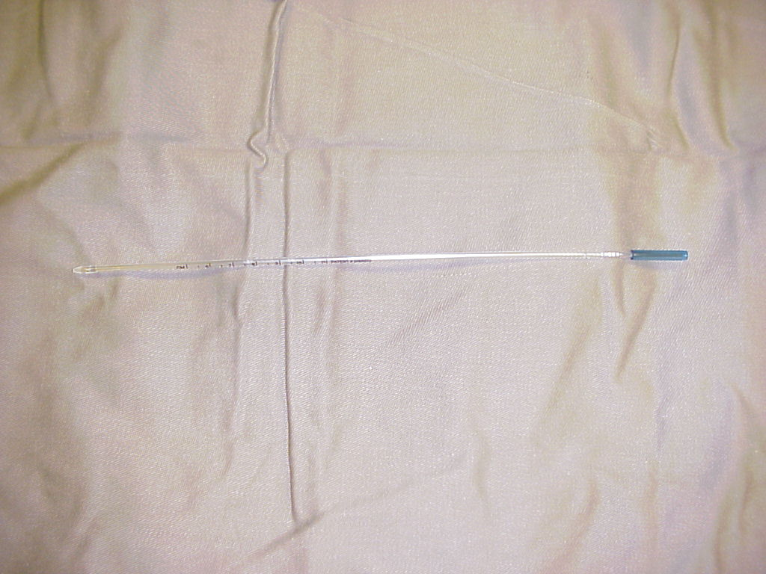
Endometrial aspirator

Slide 80
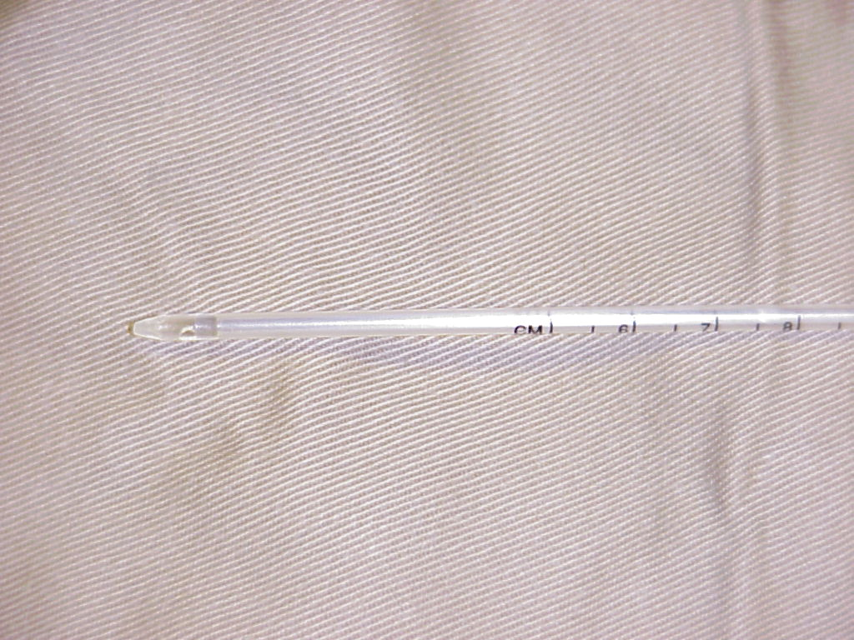
Endometrial aspirator

Slide 81
Endometrial aspiration
Sensitivity for endometrial ca 94% in patient with symptoms
sensitivity for hyperplasia 31%
Cons: discomfort to patient
lack of known efficiency in asymptomatic patients

Slide 82
TVS in endometrial ca screening
Croatia study (Kurjak 1994)
5013 asymptomatic women
ca endometrium 6 and hyperplasia 18, no false positive
(low prevalence of ca endometrium in asymptomatic patients, ?

Slide 83
THE END

