Slide 1
Benign Diseases of the Ovary
Dr. Mona A. Almushait
Dean, Girl’s Centre
Associate Professor & Consultant in Ob-Gyne
King Khalid University
Abha, Saudi Arabia

Slide 2
The Ovary
The human ovary has a striking propensity to develop a wide variety of tumors, most of which are benign.
90% of all ovarian tumors are benign, although this varies with age.

Slide 3
DIFFERENTIAL DIAGNOSIS OF OVARIAN MASSES
Pathogenesis | Specific Type
Functional | Follicular cysts
 | Lutein cysts
 | Polycystic ovaries
Inflammatory | Salpingo-oophoritis
 | Pyogenic oophoritis-puerperal, abortal, or related to an intrauterine device
 | Granulomatous oophoritis
Metaplastic | Endometriomas
Neoplastic | Premenarchal years-10% are malignant
 | Menstruating years-15% are malignant
 | Postmenopausal years-50% are malignant

Slide 4
Benign Ovarian Tumors
Presentation:
Asymptomatic
Pain
Abdominal swelling
Pressure effects
Menstrual disturbances
Hormonal effects
Abnormal cervical smear

Slide 5
Asymptomatic
Many benign ovarian tumors are found incidentally during a routine examination.
Ultrasound was used in trials of screening for ovarian cancer, the majority of tumors detected were benign.

Slide 6
Pain
Abdominal swelling
If the tumor is very large
A benign mucinous cyst
Acute pain
Torsion
Rupture
Haemorrhage
Infection
Chronic lower abdominal pain
Pressure of a benign ovarian tumor
More common if endometriosis
or infection is present

Slide 7
Functional Ovarian Cysts and Tumors
Occur only during menstrual life

Slide 8
Functional cyst
If the egg is not released, or if the sac-like structure closes up after the egg is released and starts swelling up, a cyst is formed.
They may cause pelvic pain, a dull sensation, or heaviness in the pelvis.

Slide 9
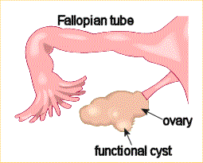
An image of a Functional cyst

Slide 10
Follicular cyst
The commonest benign ovarian tumor, and may be multiple and bilateral.
Lined by one or more layers of granulosa cells, develops when an ovarian follicle fails to rupture.
These cysts commonly occur during treatment with clomiphene or human menopausal gonadotropin.

Slide 11
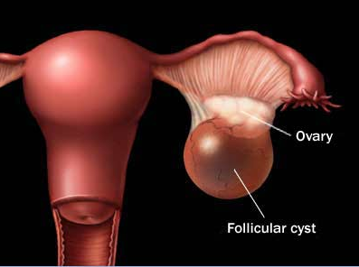
A follicle cyst includes a thin smooth wall, anechoic contents, and unilocular with good acoustic enhancement .

Slide 12
Lutein cyst
Grows to 4–6 cm, and fails to regress normally after 14 days.
Persistent production of progesterone may result in amenorrhea or delayed onset of menstruation.
Hemorrhagic cyst
Hemorrhagic corpus luteum cysts lead to haemoperitoneum.

Slide 13
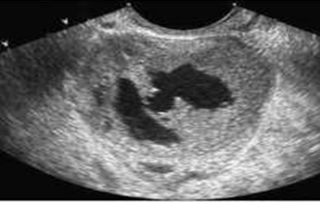
Hemorrhagic cyst with unusual appearance simulating a neoplasm

Slide 14
Theca–lutein cyst
May develop in association with the high levels of hCG present in patients with a hydatidiform mole or choriocarcinoma
Patients undergoing ovulation induction with gonadotropins or clomiphene
Are usually bilateral
Surgical intervention if there is haemorrhage.

Slide 15
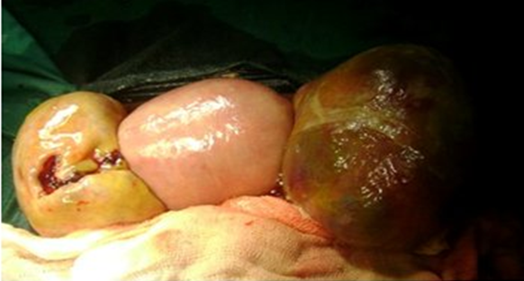
Shows enlarged uterus in the centre and bilateral Theca lutein cysts. The cyst on the left shows a breach in the capsule and the right cyst with thin hemorrhagic area suggestive of impending rupture

Slide 16
Benign Neoplastic Ovarian Tumors
Ovarian neoplasms may be divided generally by cell type of origin into three main groups:
Epithelial
Stromal
Germ cell
Taken as a group, the epithelial tumors are by far the most common.
Although the single most common benign ovarian neoplasm is the benign cystic teratoma (dermoid cyst),which is a germ cell tumor.

Slide 17
EPITHELIAL OVARIAN NEOPLASMS
Serous cystadenomas
Mucinous cystadenomas
Brenner cell tumors

Slide 18
Serous cystadenomas
Commonest cystic ovarian tumors.
Multilocular
Gross appearance of a mucinous (A) and serous (B) cystadenoma of the ovary. The mucinous type is generally multiloculated and can be quite large.

Slide 19
Mucinous cystadenomas
The second most common epithelial tumor
Unilateral and multilocular cysts
About 85% are benign
The fluid content consists of mucin and the only treatment is to remove the tumor surgically.

Slide 20
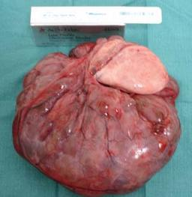
Gross image showing mucinous cystadenomas
tumor attached the left ovary.

Slide 21
Brenner tumor
The Brenner cell tumors are commonly solid and occur in women after the age of 50 years.
It is a small, smooth solid ovarian neoplasm, usually benign and occasionally bilateral.
Treated by local excision.

Slide 22
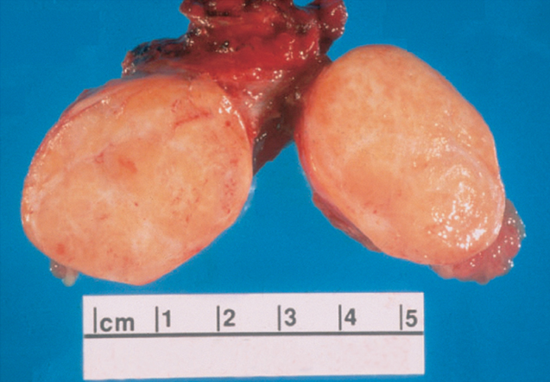
Gross appearance of a cut-open Brenner tumor.

Slide 23
2. SEX CORD STROMAL OVARIAN NEOPLASMS
Hormone secreting tumors of the ovary.
These tumors include fibromas, granulosa-theca cell tumors, and Sertoli-Leydig cell tumors (Arrheno–blastomas or androblastomas).

Slide 24
Granulosa–theca cell tumor
The granulosa-theca cell tumors are arising from ovarian granulosa cells, these tumors produce oestrogens and constitute 3% of all solid ovarian tumors.
They occur in any age group, from birth on, but more commonly in the postmenopausal years.
Promotes feminizing signs and symptoms, if arising before puberty produce precocious menarche, precocious thelarche, or premenarchal uterine bleeding during infancy and childhood (precocious sexual development).

Slide 25
In the reproductive age, prolonged oestrogen stimulation results in cystic glandular hyperplasia and irregular and prolonged vaginal bleeding.
Postmenopausal bleeding may occur in older women with granulosa-theca cell tumors. If the tumor is histologically benign, the treatment is Oophorectomy.
If there is evidence of malignancy, Pelvic clearance is indicated.

Slide 26
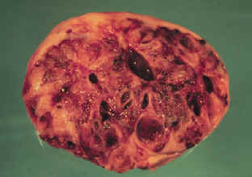
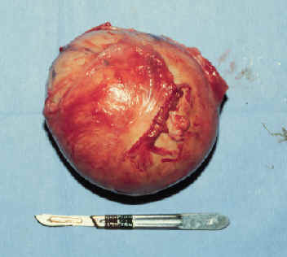
Granulosa–theca cell tumor

Slide 27
Sertoli-Leydig cell tumor (arrheno-blastomas or androblastomas)
Androgen secreting tumor
Less frequent
It generally occurs in women under 30 years of age.
These tumors are comprised of Sertoli cells which are normally found in testes and Leydig cells which secrete testosterone.
The clinical manifestations include the onset of amenorrhea, loss of breast tissue, virilizing effects, such as hirsutism, deepening of the voice, clitoromegaly, and a defeminizing change in body habitus to a muscular build.

Slide 28
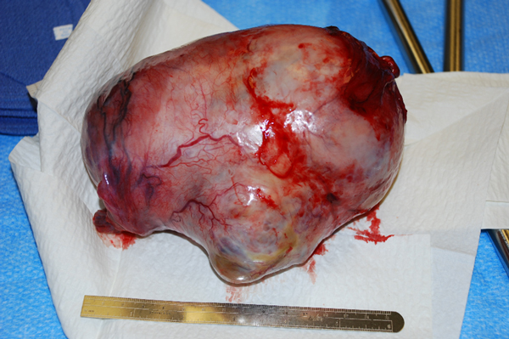
Diagnosis is by the exclusion of virilizing adrenal tumors and the identification of a tumor in one ovary.
Treatment is by the excision of the affected ovary.
The surgical excised specimen of the ovarian mass measuring 17 x 15 x 8.2 cm.

Slide 29
Ovarian fibroma
A solid, encapsulated, smooth-surfaced tumor made up of interlacing bundles of fibrocytes. It is not hormonally active.
It is associated with ascites caused by the transudation of fluid from the ovarian fibroid. The flow of this ascitic fluid through the transdiaphragmatic lymphatics into the right pleural cavity may result in Meigs' syndrome (ascites and hydrothorax in association with an ovarian fibroma).

Slide 30
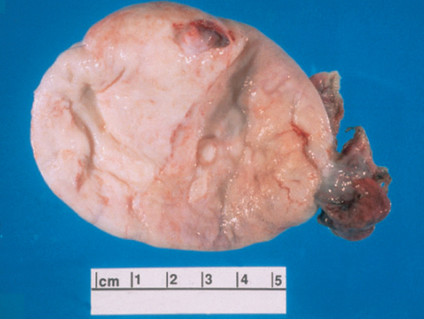
Gross appearance of an ovarian fibroma.

Slide 31
3. GERM CELL TUMORS
Tumors of germ cell origin may replicate stages resembling the early embryo.

Slide 32
Germ cell neoplasms can occur at any age.
12–15% of true ovarian neoplasms.
They make up about 60% of ovarian neoplasms occurring in infants and children.
The most common ovarian neoplasm is the Benign cystic teratoma, a germ cell tumor that can take on a great variety of forms, with virtually all adult tissues being represented within the mass.

Slide 33
Benign cystic teratoma
Commonly referred to as a Dermoid cysts which are the commonest solid ovarian neoplasm found in young women.
Is composed primarily of ectodermal tissue (such as sweat and sebaceous glands, hair follicles, and teeth), with some mesodermal and rarely endodermal elements.
Commonly asymptomatic unless they undergo torsion or rupture and releases sebaceous material that causes chemical peritonitis.
Dermoid cysts are bilateral in 12% of cases, and becomes malignant in approximately 2%.
Treatment: Excision of the dermoid cyst

Slide 34
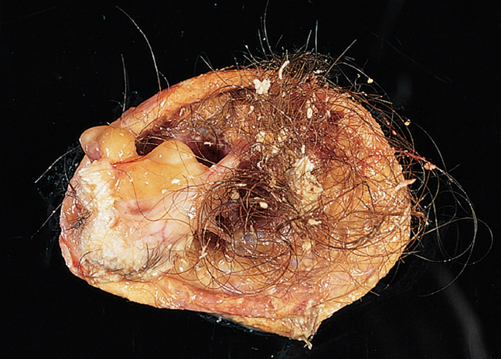
Gross appearance of a cut-open dermoid cyst.
Note the presence of hair-bearing skin.

Slide 35
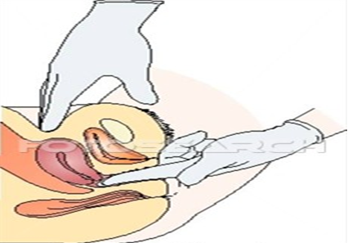
Investigation
Bimanual examination involves palpating the organs
between both hand.

Slide 36
Pelvic ultrasonography
Tumor markers, such as Serum CA 125, may help to distinguish between benign and malignant masses
Laparoscopy
Laparotomy

Slide 37
Serum CA 125

Slide 38
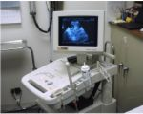
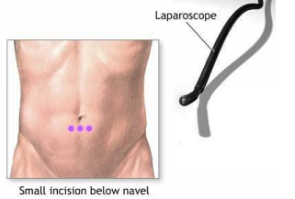
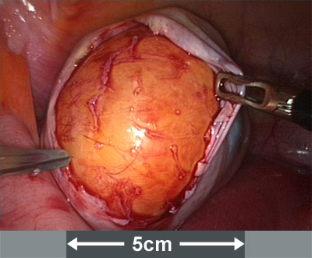
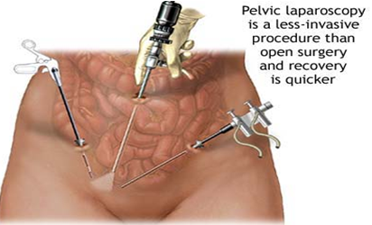
Ultrasonography
Laparoscopy

Slide 39
Management
Surgical exploration and pathologic examination
Laparotomy
Cytologic examination. A frozen-section histologic diagnosis should be obtained intraoperatively to exclude malignancy.

Slide 40
The definitive treatment will depend on the type of neoplasm, the patient's age, and her desire for future childbearing.
Benign epithelial ovarian neoplasms are generally treated by Unilateral Salpingo-oophorectomy.
The contralateral ovary must be carefully inspected to exclude a bilateral lesion.

Slide 41
If the patient is young and nulliparous, the ovarian neoplasm is unilocular, and there are no excrescences within the cyst, an Ovarian Cystectomy with preservation of the ovary may be performed.
In an older woman, a Total Abdominal Hysterectomy and Bilateral Salpingo-oophorectomy.

Slide 42
Stromal cell neoplasms of the ovary are generally treated by Unilateral salpingo-oophorectomy when future pregnancies are a consideration.
Ovarian fibromas, even when associated with ascites and a right hydrothorax (Meigs' syndrome), are almost always benign and might even be treated by Resection from the ovary in a young woman.

Slide 43
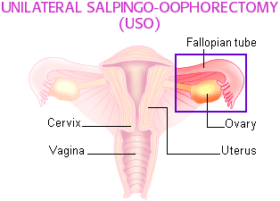
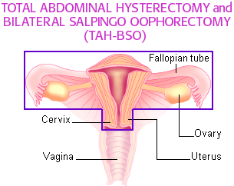
For some very early tumors (stage 1, low grade or low-risk disease), only the involved ovary and fallopian tube may be removed (called a “Unilateral Salpingo-Oophorectomy," USO), especially in young females who wish to preserve their fertility and have children.
If all of these structures are removed, the surgery is called a “Total Abdominal Hysterectomy and Bilateral Salpingo-Oophorectomy”
(TAH-BSO).

Slide 44
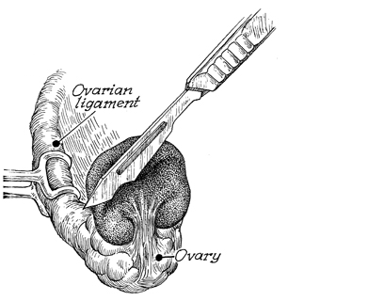
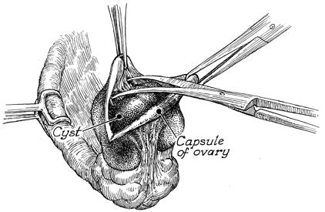
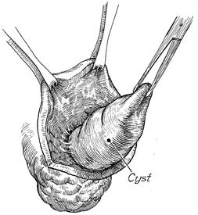
Ovarian Cystectomy
It is performed in those benign conditions of the ovary in which a cyst can be removed and when it is desirable to leave a functional ovary in place.

Slide 45
Thank you

