Slide 1
Urinary Problems
in Obstetrics and Gynaecology
Dr. Mona A. Almushait
Dean, Girl’s Centre
Associate Professor & Consultant
Obstetrics and Gynaecology
College of Medicine
King Khalid University

Slide 2
Common Disorders of Bladder Dysfunction
The common symptoms of bladder dysfunction:
Urinary incontinence
Frequency of micturition
Dysuria
Urinary retention

Slide 3
Anatomy and Physiology of the Lower Urinary Tract
The urethra is a muscular tube, 3–4 cm in length, lineal proximally with transmittal epithelium and distally with stratified squamous epithelium.
It is surrounded mainly by smooth muscle.
It transports urine stored from the bladder to an opening outside the body.

Slide 4
Continence Control
The normal bladder holds urine because the intraurethral pressure exceeds the intravesical pressure.
I. Incontinence of Urine
Is the involuntary loss of urine that is objectively demonstrable and is a social or hygienic problem.
True incontinence
Stress incontinence
Urge incontinence
Mixed urge & stress incontinence

Slide 5
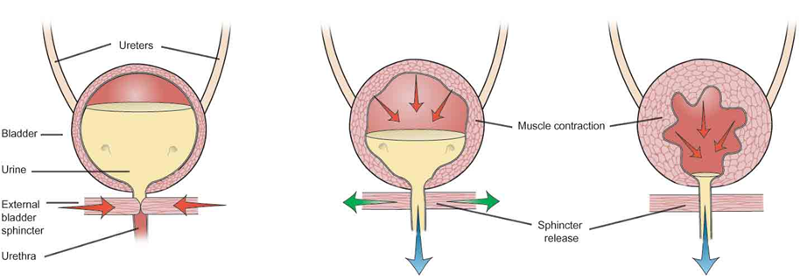

Slide 6
True Incontinence
Incontinence of Urine
Continuous loss of urine through the vagina
Associated with fistula formation
2. Stress Incontinence
Involuntary loss of urine
Pelvic floor weakness
Detrusor instability

Slide 7
3. Urge Incontinence
Sudden detrusor contraction
Uncontrolled loss of urine
Idiopathic detrusor instability
Urinary infection
Obstructive uropathy
Diabetes
Neurological disease
4. Mixed Urge and Stress Incontinence
Urge incontinence and stress incontinence

Slide 8
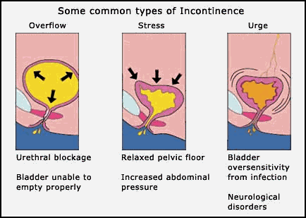

Slide 9
II. Urinary Frequency
Urinary frequency is an insuppressible desire to void more than seven times a day or more than once a night.
Causes:
UTI
Pregnancy
Diabetes
Pelvic masses
Renal failure
Excess fluid intake
Anxiety

Slide 10
III. Dysuria
Local urethral infection or trauma causes burning or scaldingduring micturition
Suprapubic pain
Urethritis, vaginitis, vaginal infection

Slide 11
IV. Urinary Retention and Outflow Obstruction
After vaginal delivery and episiotomy
Following operative delivery
Posterior colpoperineorrhaphy
Menopausal women
Retroverted uterus (pregnancy)
Inflammatory lesions of the vulva
Untreated over–distention of the bladder(following delivery), neuropathy or malignancy

Slide 12
Diagnosis
History
Cystoscopy
Intravenous urogram
Urinary analysis and culture

Slide 13
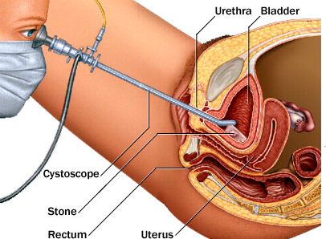
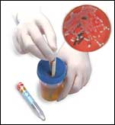
Cystoscopy
Urinalysis & Culture

Slide 14
Stress Urinary Incontinence
SUI is involuntary leakage of urine in response to physical exertion, sneezing or coughing.
Pathophysiology of SUI
A. Urethral hypermobility due to vaginal wall relaxation, displacing the bladder neck and proximal urethra downward.
This lead to increased intra–abdominal pressure from coughing, sneezing or physical exertion.

Slide 15
The normal urethral resistance is overcome by this increased bladder pressure and leakage of urine results.
B. Intrinsic sphincter deficiency
Diagnostic Test
SUI is present if short spurts of urine escape simultaneously with each cough.
Urethroscopy
Cystometrogram
Urethral pressure measurements
Uroflowmetry
Voiding cystourethrogram
Ultrasonography

Slide 16
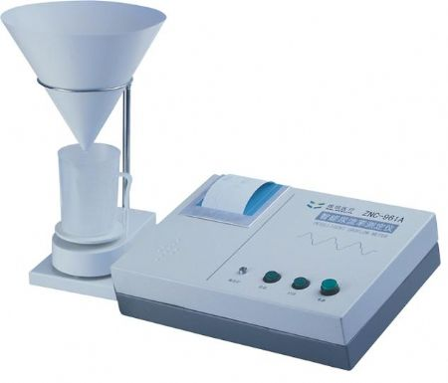
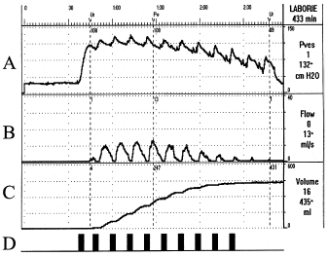
Uroflowmetry
Cystometrogram

Slide 17
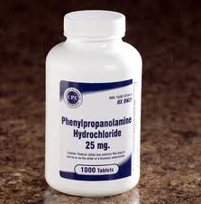
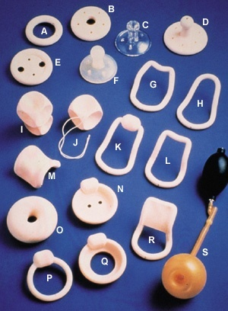
Physical Therapy
Pelvic floor muscle exercises
Medical Treatment
α-adrenergic–stimulants Phenylpropanolamine and Pseudolphedrine
Intravaginal Devices
Pessaries to elevate and support the bladder neck and urethra

Slide 18
Surgical Therapy
Surgery is the most commonly employed treatment for SUI.
The aim of all surgical procedures is to correct the pelvic relaxation defect and to stabilize and restore the normal supports of the urethra.
The approach may be vaginal, abdominal or combined abdominovaginal.

Slide 19
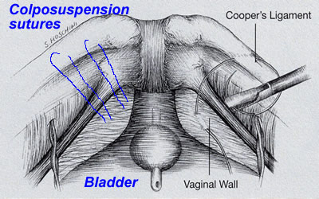
Abdominal APPROACH →
(Marshall–Marchetti–KrantzProcedure)
or (Burch Procedure)
(Burch Colposuspension)
Notes:
is defined as the

Slide 20
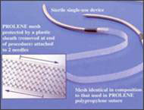
Vaginal APPROACH
Suburethral sling procedures
Modified sling procedures
(Tension free vaginal tape (TVT)

Slide 21
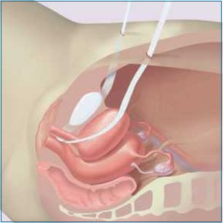
Tension free vaginal tape Procedure

Slide 22
Detrusor Instability
Detrusor instability is characterized by uncontrolled contraction of the bladder wall (detrusor muscle) producing urgency and sometimes leakage (urge incontinence).
Involuntary detrusor contractions cause urgency and urge incontinence, often with frequency and nocturia.

Slide 23
Detrusor over activity is the second commonest cause of female urinary incontinence behind stress incontinence.
Risk factors include multiple sclerosis and stroke but most cases have no specific cause.
Symptoms
Frequency of micturition
Nocturia
Abdominal discomfort
Urge incontinence

Slide 24
Investigations
Mid-stream urine M,C and S; to rule out urinary tract infection.
Investigations to consider differential diagnosis, e.g. renal function, electrolytes, fasting glucose.
Urodynamic studies show involuntary contraction of bladder during filling.
Depending on the presentation, ultrasound of the renal tract and cystoscopy may be required.
Management
Pelvic floor exercises and bladder training

Slide 25
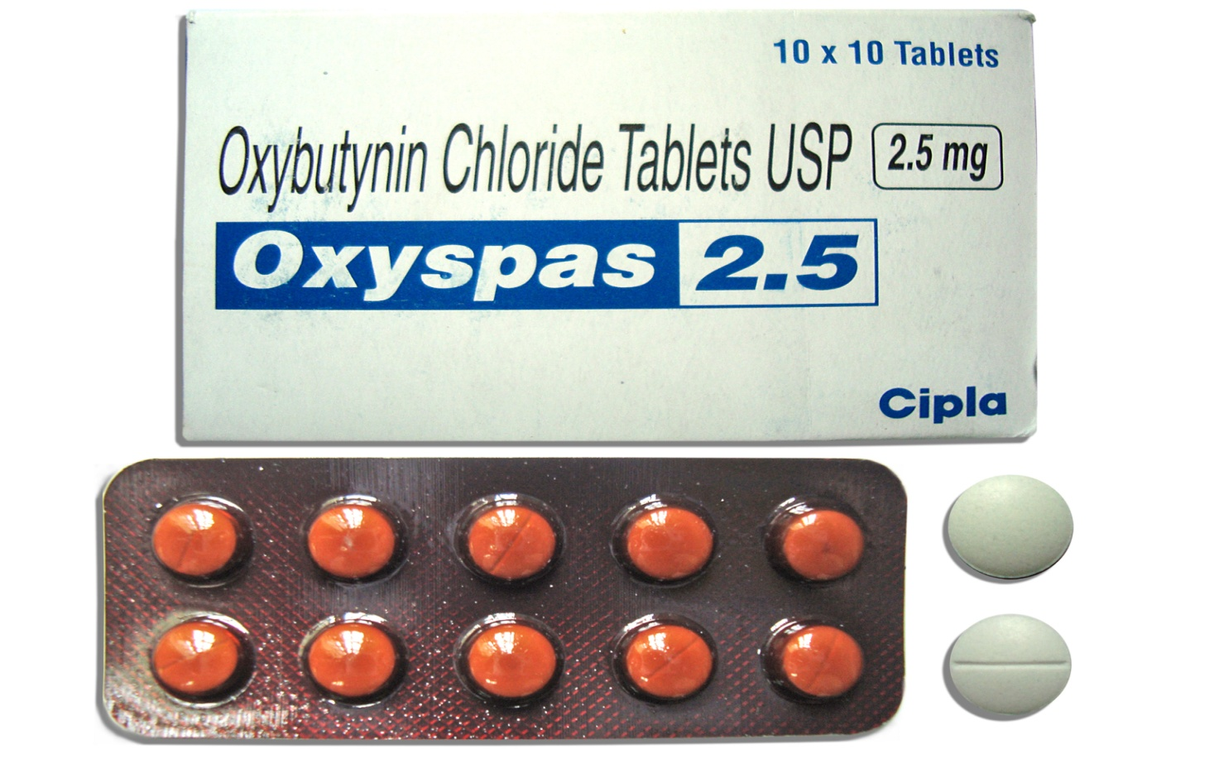
Drugs
Anticholinergics, e.g. oxybutynin, propiverine, tolterodine, trospium chloride, have a direct relaxant effect on urinary smooth muscle.

Slide 26
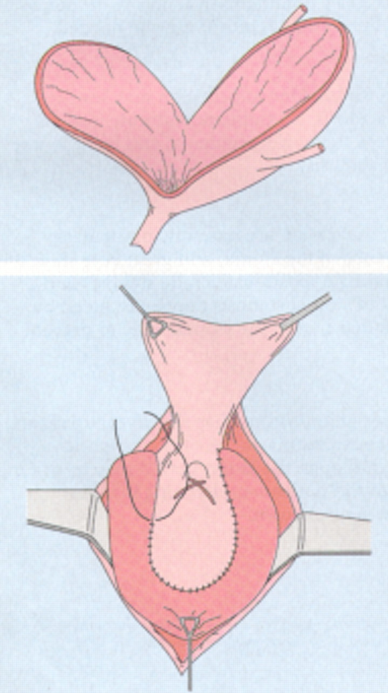
Surgery
Surgery is only indicated for intractable and severe detrusor over activity.
The most common procedure is an ileocystoplasty, in which the bladder is opened and a patch of ileum sutured into the bladder like a patch.

Slide 27
Urge Urinary Incontinence and Overactive Bladder
Urge urinary incontinence (UUI) is defined as the involuntary leakage of urine accompanied by or immediately preceded by urgency.
Overactive bladder (OAB), is defined as urgency, with or without urge incontinence, usually with frequency, and nocturia.

Slide 28
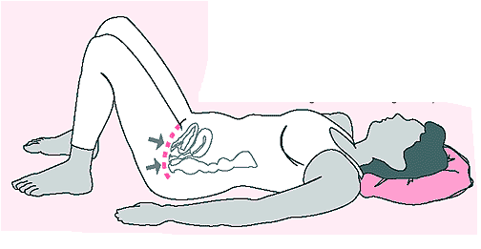
Treatment
Behavioral modification
Pharmacologic and physical intervention
Reducing fluid intake
Avoiding liquids during the evening hours
Kegel exercises
Antimuscarinics, or Anticholinergics
e.g. − Oxybutynin chloride
− Tolterodine
Functional Electrical Stimulation
(contractions of the pelvic floor and periurethral skeletal muscles)
Kegel exercises
Notes:
is defined as the

Slide 29
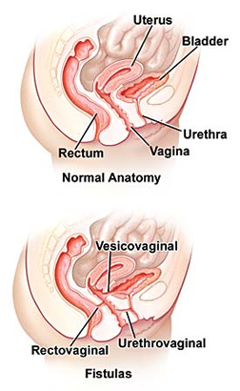
Overflow Incontinence
Urinary retention and overflow incontinence may result from detrusor areflexia or hypotonic bladder.
Urinary Fistula
Operative deliveries (forceps)
Pelvic surgery
IV radiation
Post abdominal or vaginal hysterectomy
Vesicovaginal fistula
Uterovaginal fistula
Notes:
is defined as the

Slide 30
Diagnosis
Painless and continuous vaginal leakage of urine soon after pelvic surgery.
Instillation of methylene blue dye into the bladder.
Treatment
Fistula repair in obstetric immediately on detection and for postsurgical fistula, to wait some weeks to allow the inflammation to settle.

Slide 31
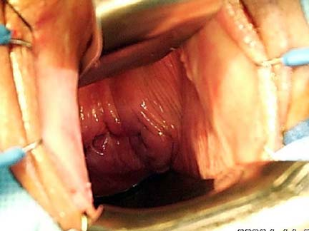
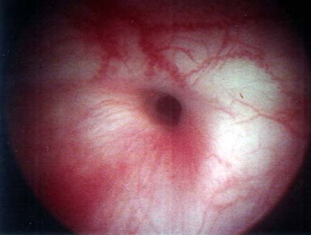
Vaginal view of vesicovaginal fistula
Cystoscopic view of vesicovaginal fistula

Slide 32
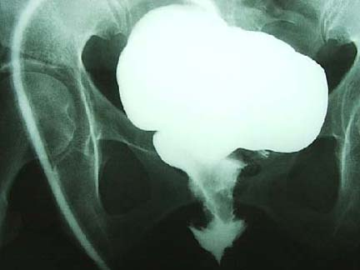
Cystogram of vesicovaginal fistula. Note the contrast extravasating from the bladder into the vaginal canal

Slide 33
Urinary Tract Infection (UTI)
UTI is one of the most frequently diagnosed infectious diseases in medical practice.
95% of UTIs are symptomatic.
Bacteriuria means the presence of bacteria in the urine.
Bacterial colony count of 10⁵ or more/milliliter of urine.
Asymptomatic bacteriuria is significant bacteriuria with or without pyria in a patient without symptoms of UTI.

Slide 34
Pyelonephritis is a bacterial infection of the renal–parenchyma and the renal pelvicaliceal system.
Acute pyelonephritis is commonly associated with chills and fever, flank pain, costovertebral tenderness, urinary frequency, urgency and dysuria.
Cystitis is an inflammation of the urinary bladder. Patients with cystitis usually have symptoms of lower urinary tract irritation (dysuria, frequency, urgency, suprapubic discomfort, hematuria).
Recurrent UTI is diagnosed when two UTIs occur within 6 months or 3 or more occur during a single year.

Slide 35
Pathogenesis
Bacteria may gain entry to the urinary tract by four pathways:
The ascending route
The descending route
The hematogenous route
The lymphatic route
Notes:
is defined as the

Slide 36
Risk Factors for Urinary Tract Infection
Premenopausal
History of urinary tract infection
Frequent or recent sexual activity
Diaphragm use for contraception
Use of spermicidal agents
Increasing parity
Diabetes mellitus
Obesity
Sickle cell trait
Anatomic congenital abnormalities
Urinary tract calculi
Medical conditions requiring indwelling or repetitive bladder catheterization
Postmenopausal
Vaginal atrophy
Incomplete bladder emptying
Poor perineal hygiene
Rectocele, cystocele,
urethrocele or uterovaginal
prolapse
Lifetime history of urinary
tract infections
Type 1 diabetes mellitus

Slide 37
Investigations
Urinalysis
Microscopic examination
Pyuria
Urine Culture and Microbiology
E.coli is the predominant organism in 80% to 85% of patients.
Klebsiella, Enterobacter, Proteus, Enterococcus, and Staphylococcus species and group D Streptococcus.
Notes:
is defined as the

Slide 38
Three Techniques for Urine Collection:
The midstream clean–catch method
Urethral catheterization
Suprapubic aspiration
Radiologic Studies
Intravenous pyelography
Computed tomographic urography
Cystography and
voiding urethrocystography
Endoscopic Studies
Urethroscopy
Cystoscopy
Renal Function Test
Urea nitrogen
Serum creatinine
Notes:
is defined as the

Slide 39
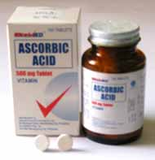
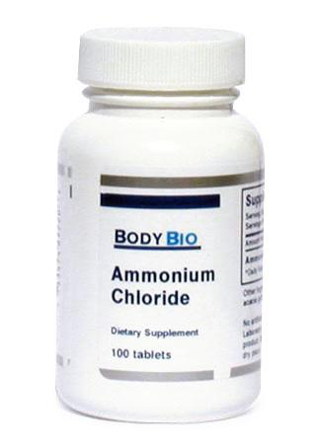
Management
Rest and hydration
Acidification of the urine
− Ascorbic acid (500 mg twice daily)
− Ammonium chloride (12 g/day in divided doses)
Notes:
is defined as the

Slide 40
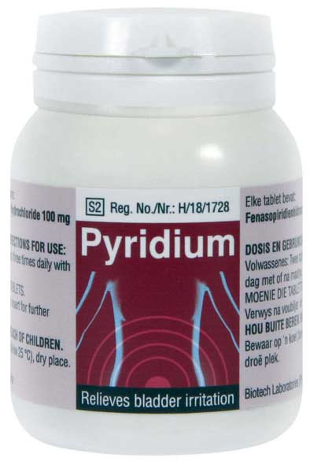
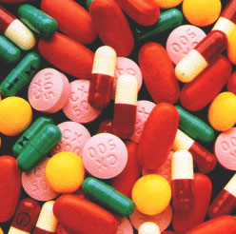
Urinary analgesics
− Phenazo–pyridine hydrochloride
(Pyridium), 100 mg twice daily
for 2 to 3 days
4. Antimicrobial therapy
− Nitrofurantoin
− Cephalosporins (e.g., Keflex, Duricef)
− Antibiotics such as ampicillin, tetracycline, and trimethoprim–sulfamethoxazole
(e.g., Septra, Bactrim)
Notes:
is defined as the

Slide 41
Common Treatments Regimens for Uncomplicated Cystitis
Antimicrobial Agent | Dose |  | Relative Cost*
Single-Dose Treatments
Ampicillin† |  | 2 g | 1
Amoxicillin† |  | 3 g | 1
Nitrofurantoin |  | 200 mg | 1
Fosfomycin tromethamine |  | 3 g (powder) | 3
Three-Day Course
Ampicillin† |  | 250 mg 4 times daily | 1
Amoxicillin† |  | 500 mg 3 times daily | 1
Trimethoprim |  | 100 mg twice daily | 2
Ciprofloxacin |  | 250 mg twice daily | 3
Seven-TO 10-Day Course
Nitrofurantoin |  | 100 mg at bedtime | 3
Nitrofurantoin macrocrystals |  | 50-100 mg 4 times daily | 4
*Relative cost: 1–4, less to more expensive.
† Resistance among more common uropathogens is increasing.

Slide 42
THANK YOU !

